Slide 1
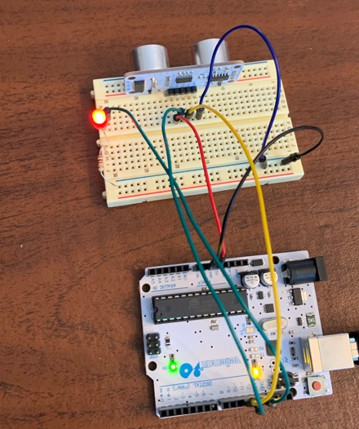
L8.10 - Infrasound & Assignment 8.3

Slide 2
Assignment #8.3
Implement a distance measuring system using the ultrasound sensor & OLED display in your kit:
measure object distance from ~ 5 to 200 cm
Continuously display distance to detected object in cm using your 4-digit, 7-segment display with 1 cm resolution
Due Saturday 5/10/25

Slide 3

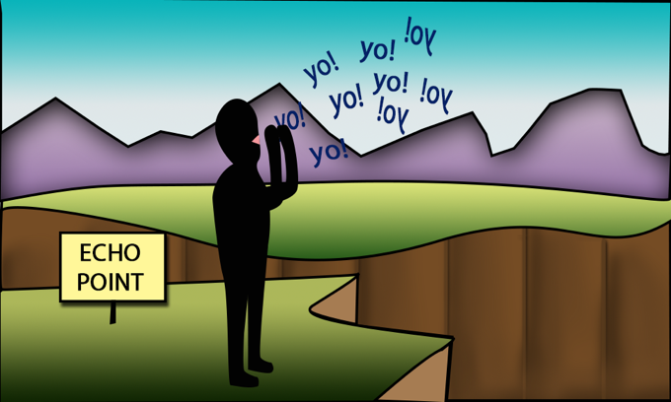
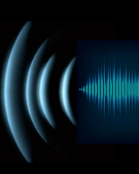
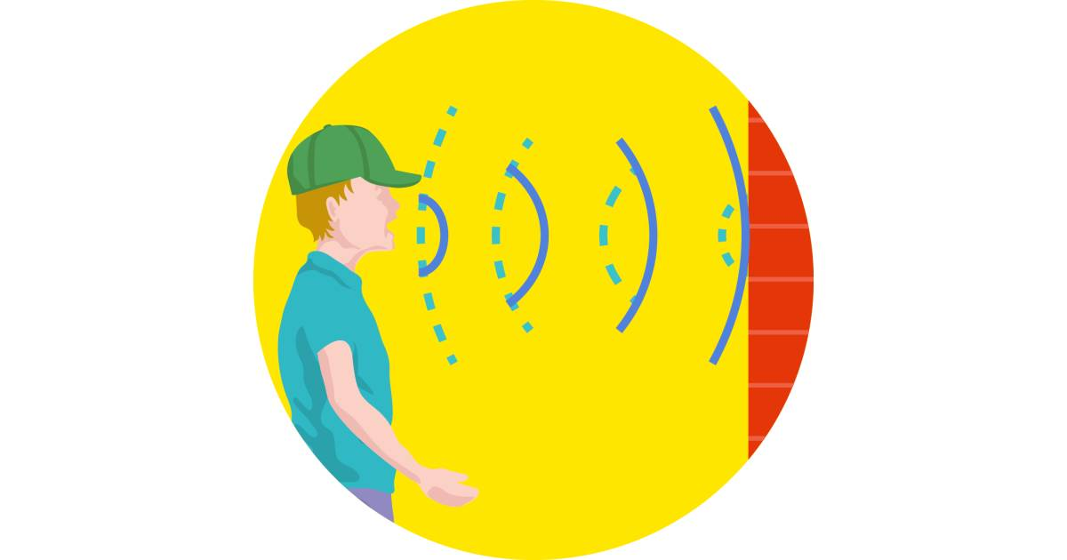
Echo
human hearing range:
20 Hz – 20,000 Hz (20 kHz)

Slide 4
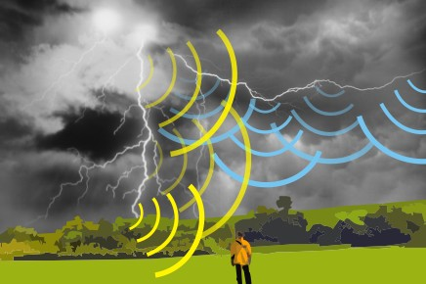
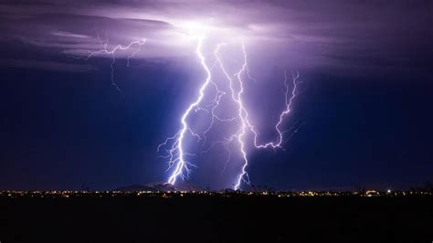
Speed of sound:
343 m/s
741 mph
1,125 ft/s
speed of light:
300,000,000 m/s
983,571,056 ft/s

Slide 5
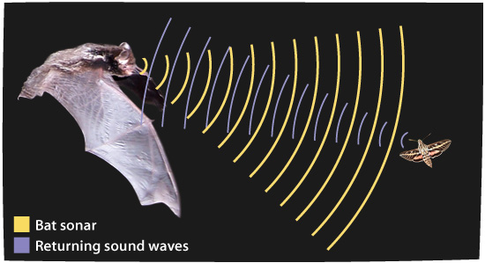
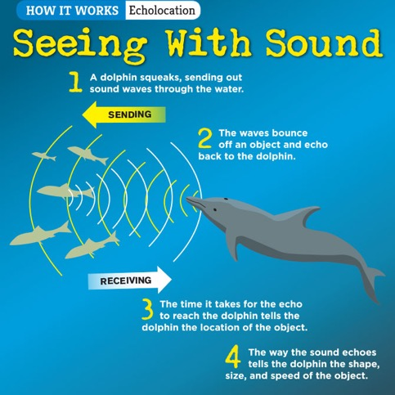
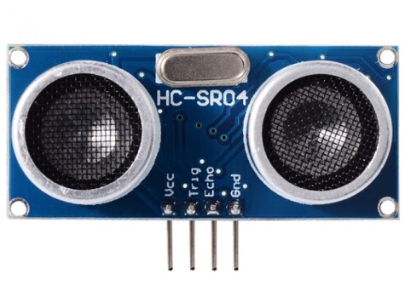
Ultrasonic SONAR
bats, dolphins “see” (navigate) using sound waves above 20KHz
HC-SRO4 is a 40 KHz SONAR

Slide 6
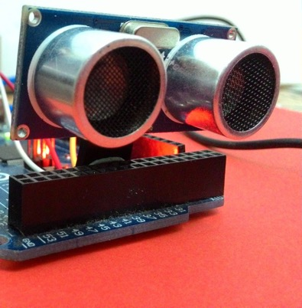
Ultrasonic Distance Sensor HC-SR04
& ATmega328P
Tx
Rx
echo signal
distance R
speed of sound: V_{s} = 343 m/s; 34,300 cm/s
object
10 us
10 usec wide 5V pulse provided to trigger the sensor via a GPIO output pin
Trig
sensor transmitter emits a 40 KHz burst of sound. Bounces off target and returns to sensor receiver 2R/V_{s} seconds later
tx waveform
rx waveform
sensor creates an echo pulse of width T = 2R/V_{s} Code measures time difference between rising & falling edge of pulse.
Echo
T=2R/Vs

Slide 7
Speed of sound: V_{s} = 343 m/s = 34300 cm/s = 34300 x 10⁻⁶ cm/uS = 0.034 cm/uS
Echo
T=2R/Vs
Example: R = 10 cm; T = 2*10/0.034 = 588 uS
echo pulse width T = 2R/V_{s}
# Timer clock tics at 64 uSec per tic

Slide 8
Timer/Counter
8
pre-load timer with 0x00
apply clock
Counter Register will count up
Arduino Uno board has 16 MHz Clock
clk_{IO} = 16,000,000 cycles/second; 0.0625 uSec/cycle
clk/8 = 2,000,000 cycles/second, 0.5 uSec/cycle
clk/64 = 250,000 cycles/second, 4 uSec/cycle
clk/256 = 62,500 cycles/second, 16 uSec/cycle
clk/1024 = 15,625 cycles/second, 64 uSec/cycle
0x00

Slide 9
Let us measure the duration (width) of a pulse connected to a GPIO pin, for example PB1
start a timer counting (normal mode; 16 MHz clock/1024)
wait for the PB1 to go high
Tr = # clock cycles to the rising edge (close to 0)
wait for PB1 to go low
Tf= # clock cycles to the falling edge (between 0 and 182)
T = Tf - Tr
(Echo) Sensor generates a pulse of duration T=2R/V_{s}
Speed of sound: V_{s} = 343 m/s = 34300 cm/s = 34300 x 10⁻⁶ cm/uS = 0.034 cm/uS

Slide 10
#define TRIG PB0
#define ECHO PB1
#include <avr/io.h> (and other includes)
int main(void){
(Trig) 10 us pulse triggers the ultrasound sensor
unsigned int timeToRisingEdge, timeToFallingEdge;
unsigned int pulseWidth;
float range;
timer0_init();
transmitter emits a 40 kHz sound wave pulse
time
while(1){
PORTB &= ~(1 << TRIG); // 5 usec pre-TRIG
_delay_us(5);
PORTB |= 1 << TRIG; // 10 us pulse
_delay_us(10); // to ultrasound
PORTB &= ~(1 << TRIG); // TRIG pin
delay time is
2R/V_{s}
TCNT0 = 0;
Pulse echo is detected by the receiver; clock is stopped
while ((PINB & (1<<ECHO))==0); //wait till ECHO goes high
timeToRisingEdge = TCNT0;
while (!(PINB & (1<<ECHO))==0); //wait till ECHO1 goes low
timeToFallingEdge = TCNT0;
pulseWidth = timeToFallingEdge - timeToRisingEdge;
range = pulseWidth * 1.098; //one way distance to target in cm
send_to_monitor();
(Echo) Sensor generates a pulse of duration T=2R/V_{s}
}
void timer0_init(void){
TCCR0A = 0; //timer mode - normal
TCCR0B = 0x05; //1024 prescaler
}
Speed of sound: V_{s} = 343 m/s = 34300 cm/s = 34300 x 10⁻⁶ cm/uS = 0.034 cm/uS

Slide 11
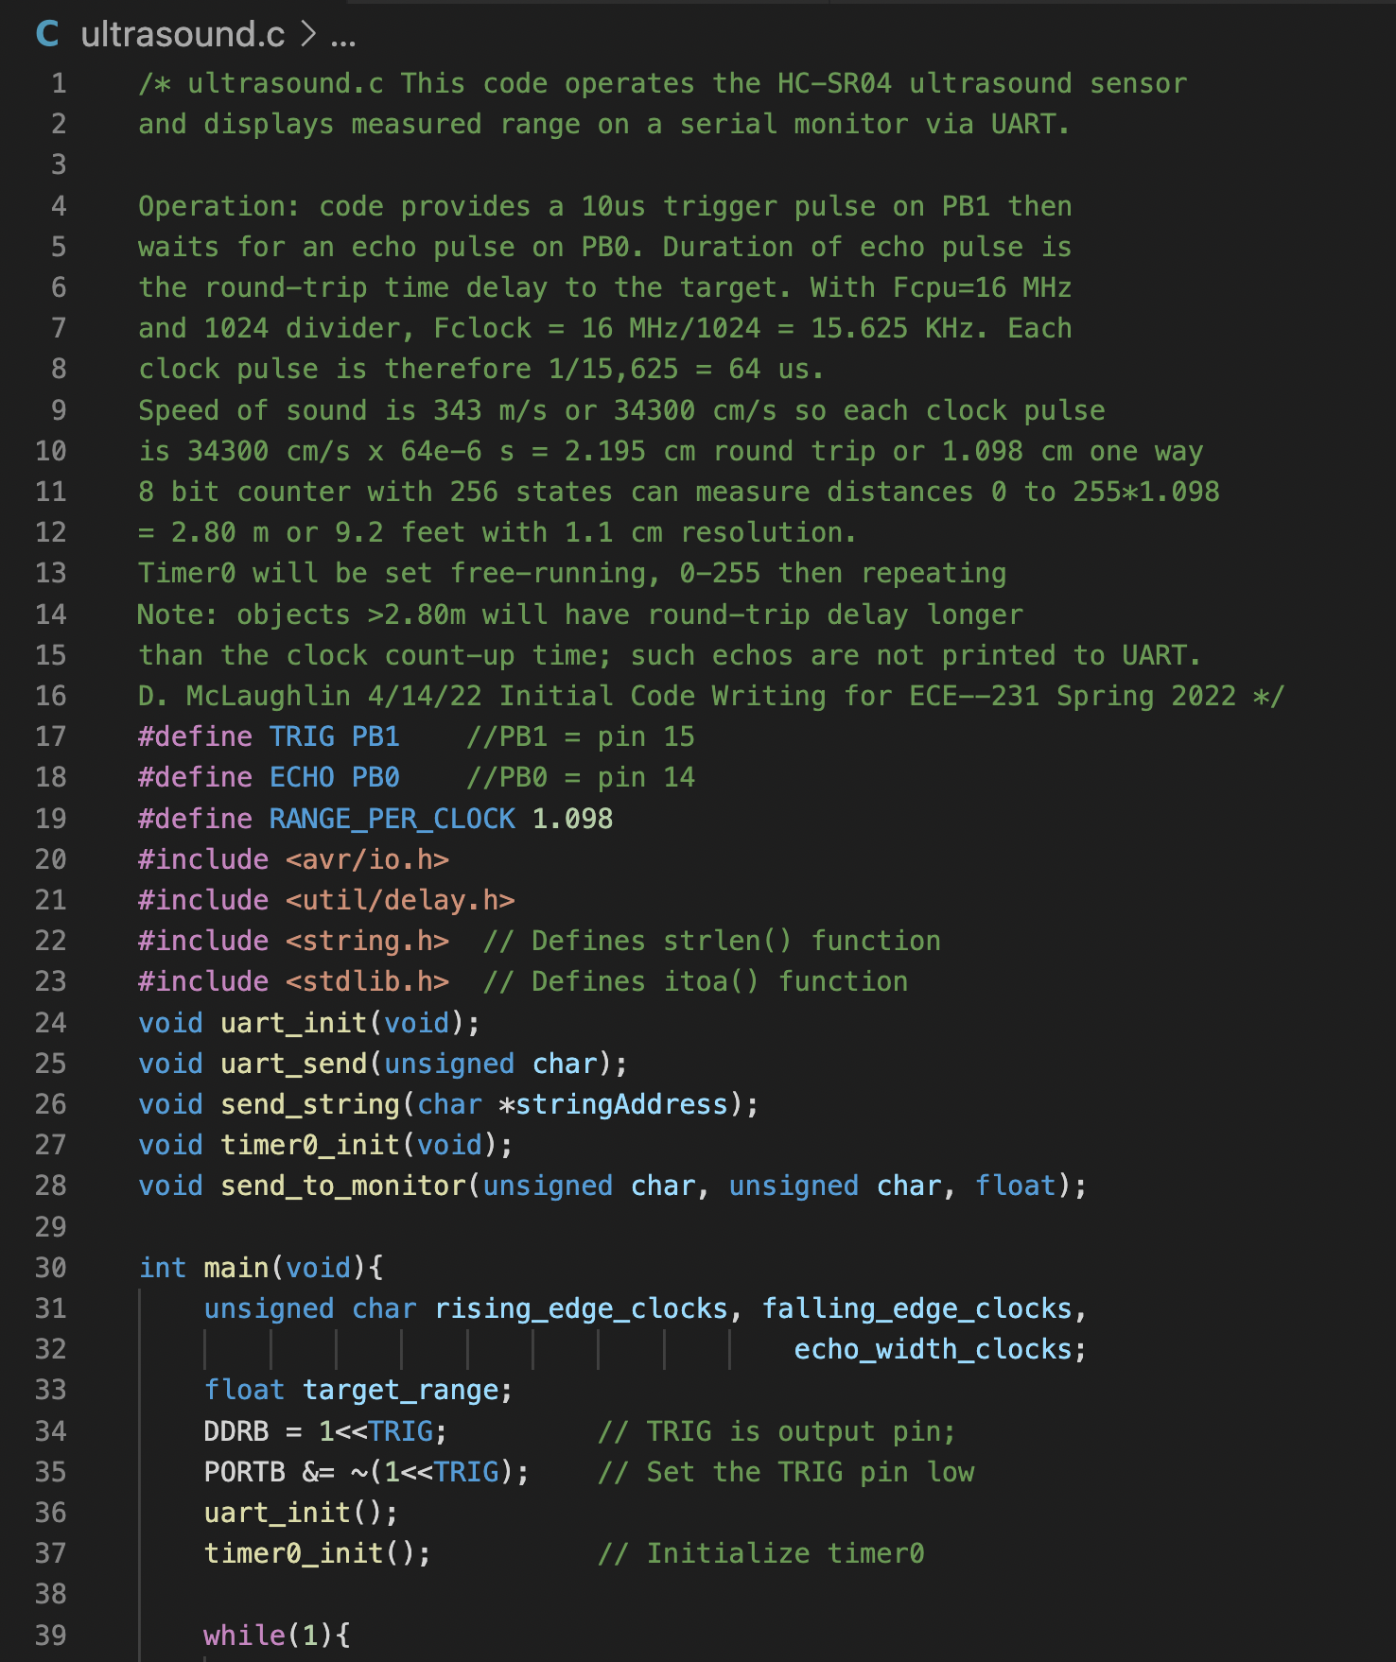

Slide 12
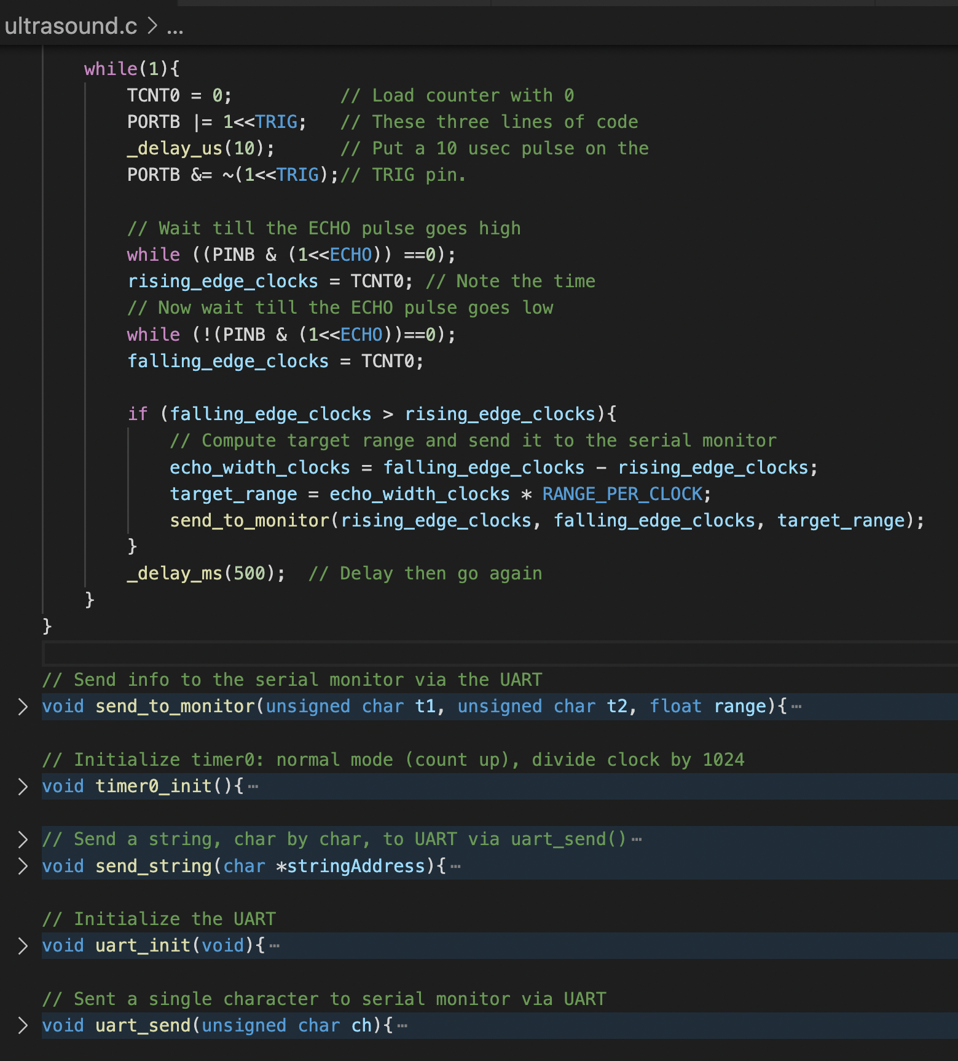

Slide 13
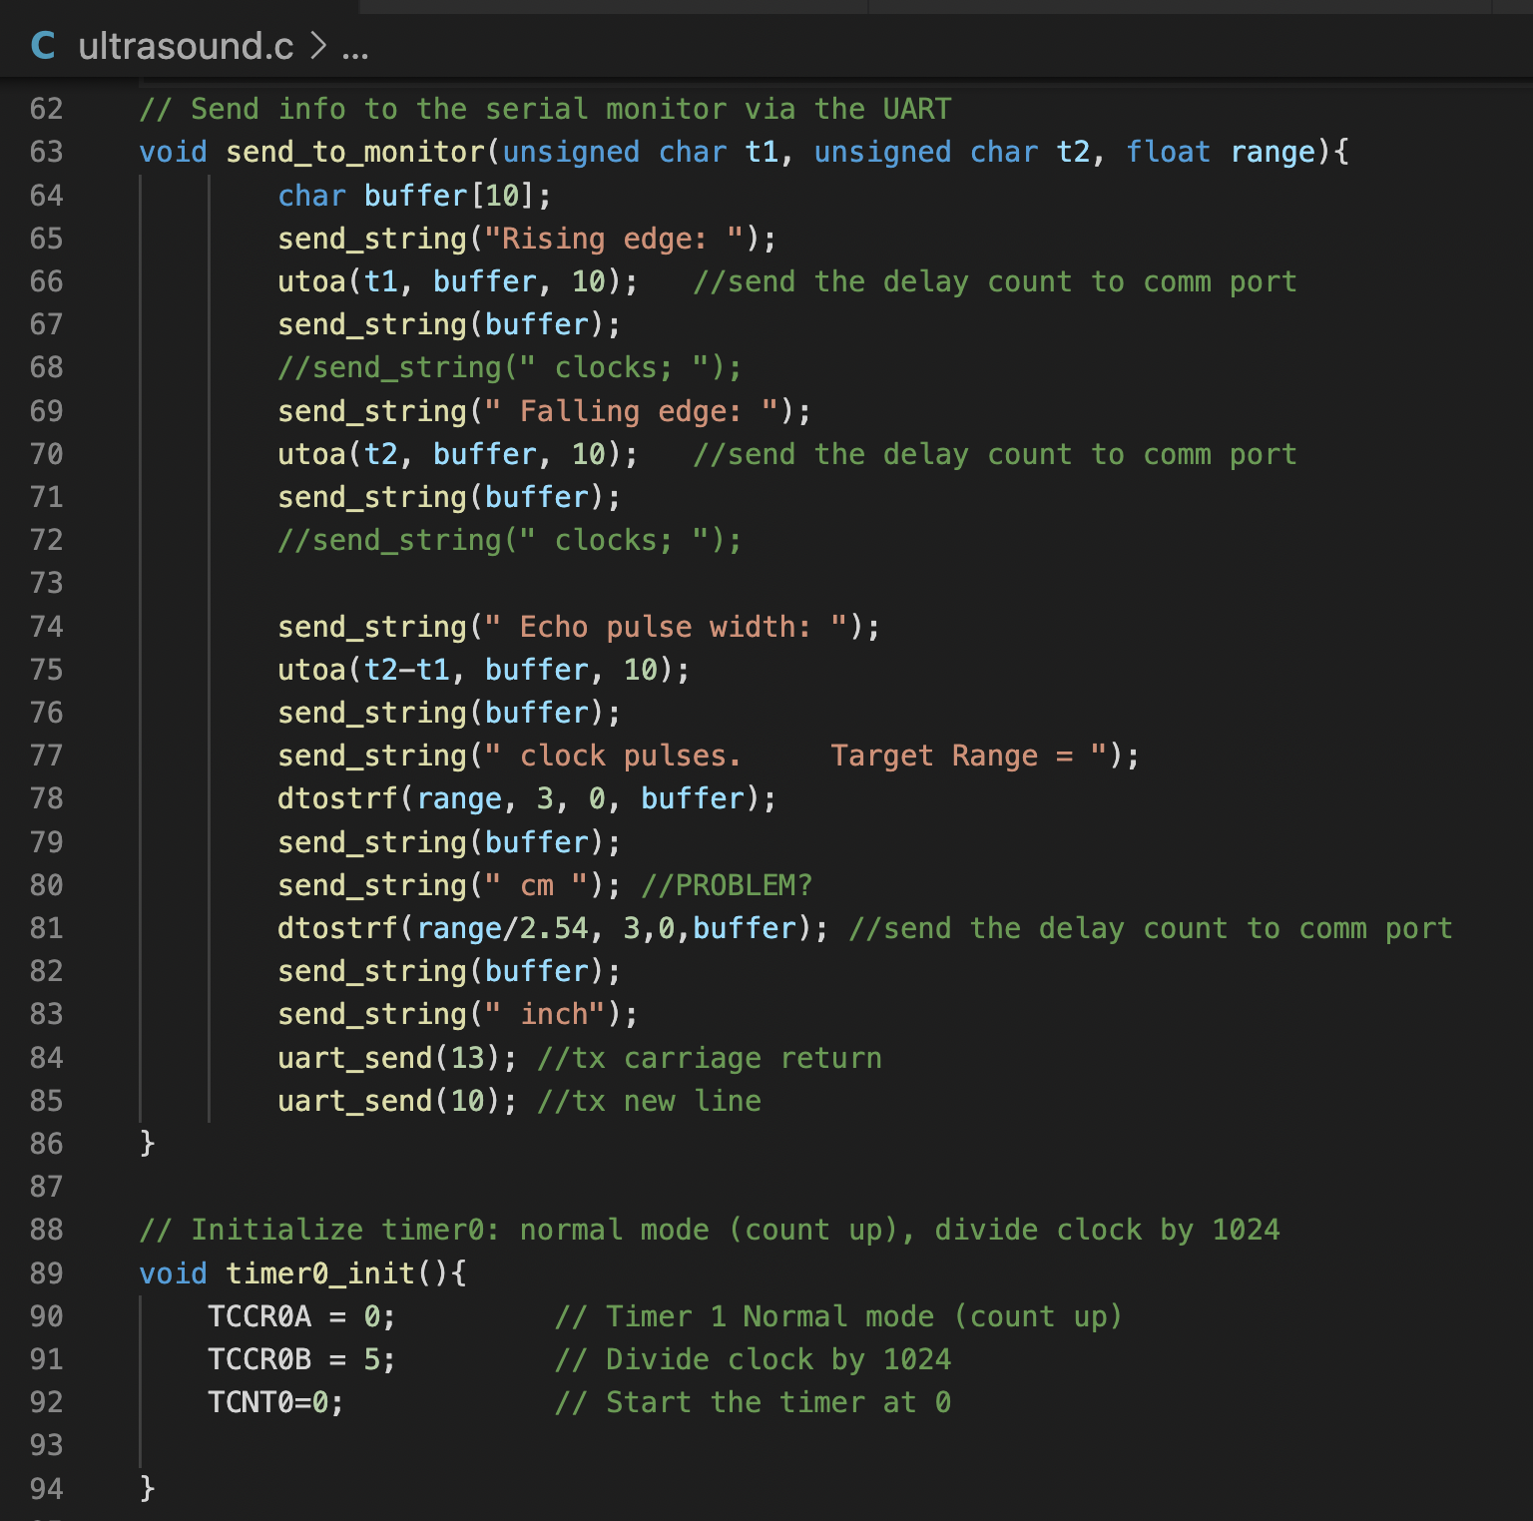

Slide 14
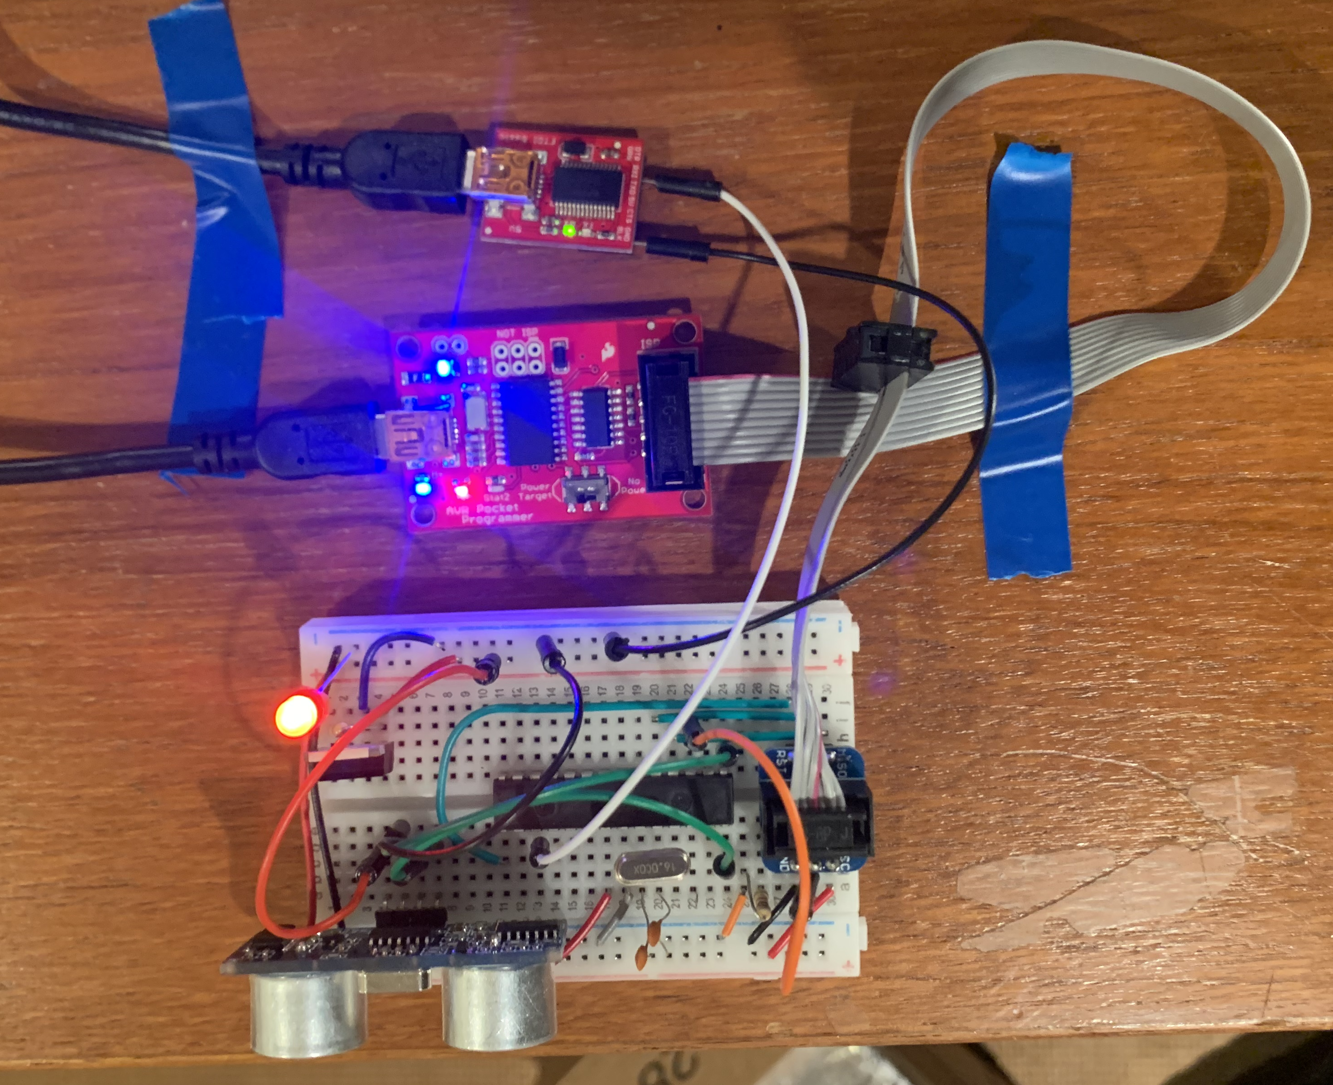

Slide 15


